Slide 1

Test Cracker
Test Cracker
By Zhou Lu, Yiren Zheng, Liyun Dai, Yi Zhou

Slide 2
Our vision:
Test Cracker is an Android application for RPI students to improve efficiency and keep track of important academic events.
We use Java to implement the basic structure of our APP
We also use Python to write a web crawler to get information of courses offered by RPI from SIS

Slide 3

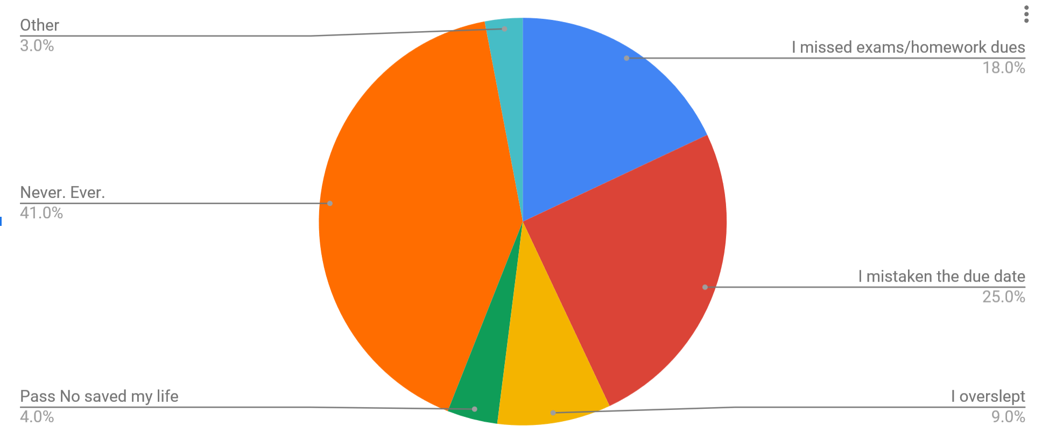
Survey & Comparing with similar products
Alpha Phi Omega
paper
donate at APO office
still updating
Test Crcker
online
update donation
expecting donation
Rpistudygroup.org
online
update donation
donation outdated

Slide 4
Database:
All relations in our database:
user(id, username, password, name, phone, createTime, loginTime, state)
course(id, name, createTime, state)
folder(id, course_id, user_id, title, content, path, fileName, createTime, likeNum, dislikeNum, state)
opinion(id, folder_id, user_id, content, attitude, createTimw, state)

Slide 5
Crawl and read Json file
webdriver - firefox
loaddata function but not work now
documentation

Slide 6
Scene 1: Preparing for Test
Exam tomorrow morning
Haven’t studied yet
What should we do ?

Slide 7
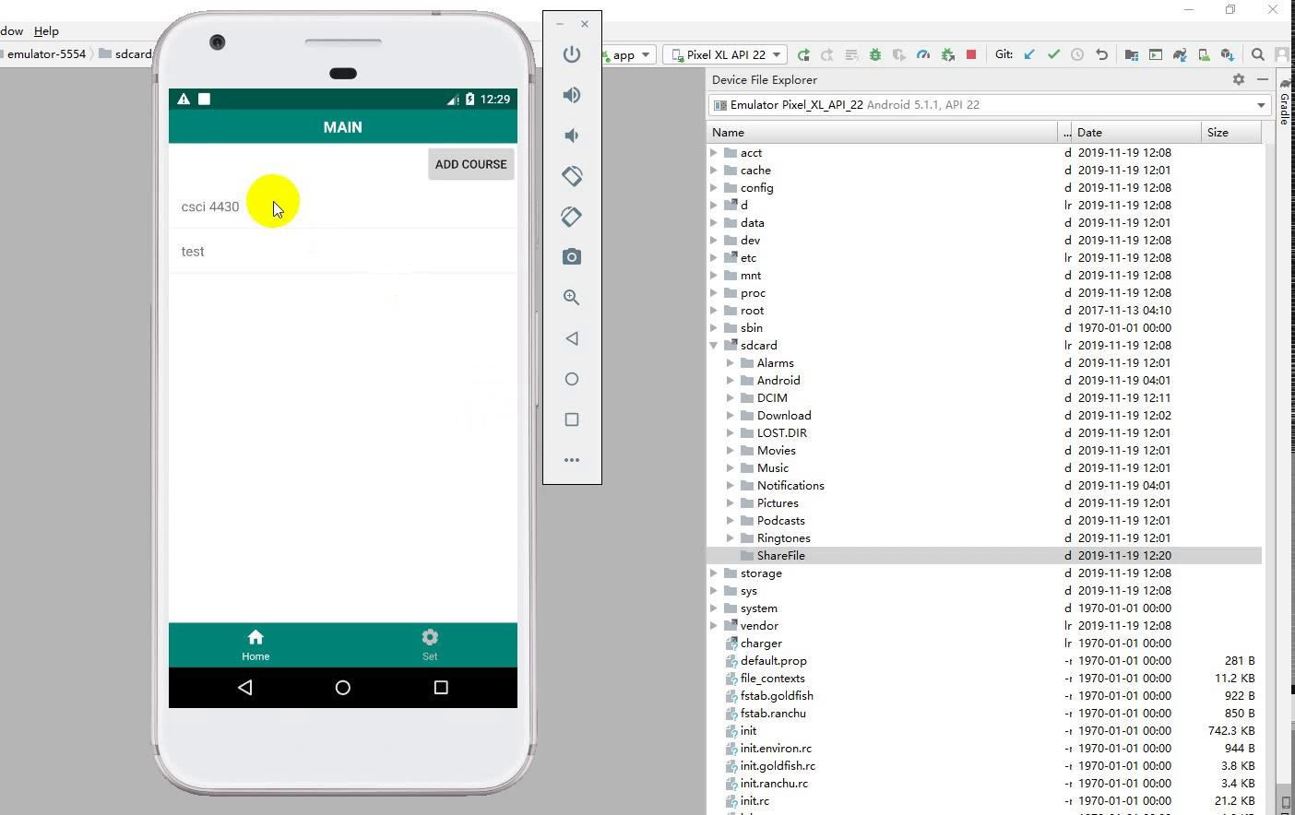
download picture(s)

Slide 8
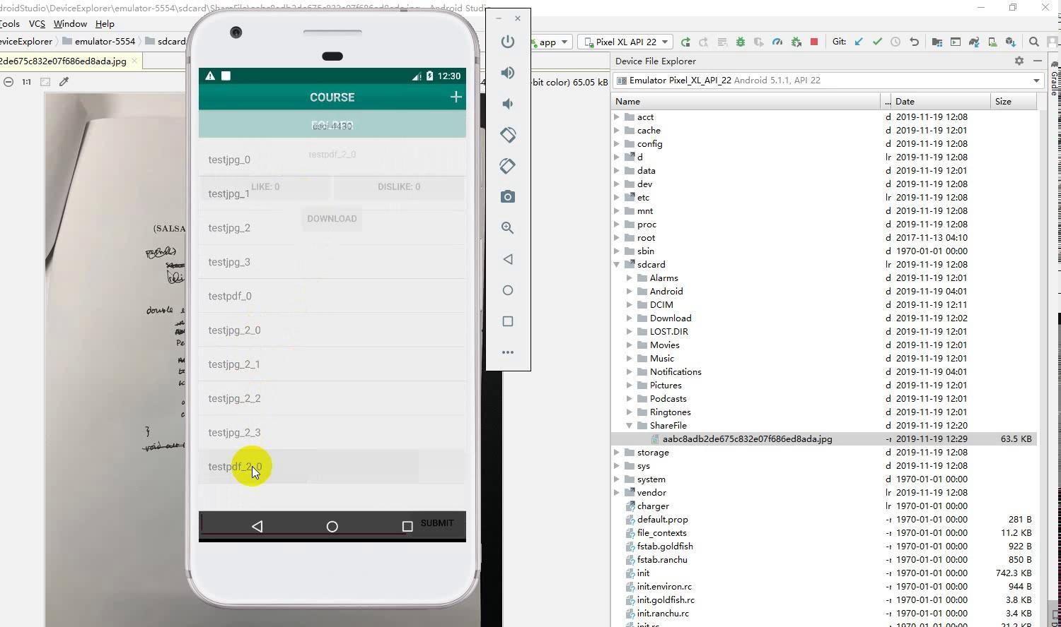
download a pdf file

Slide 9
Scene 2: Donate Test
Nailed the test
Wish to help other students
Allow multiple jpg uploading and dowloading
Support pdf version uploading and downloading

Slide 10
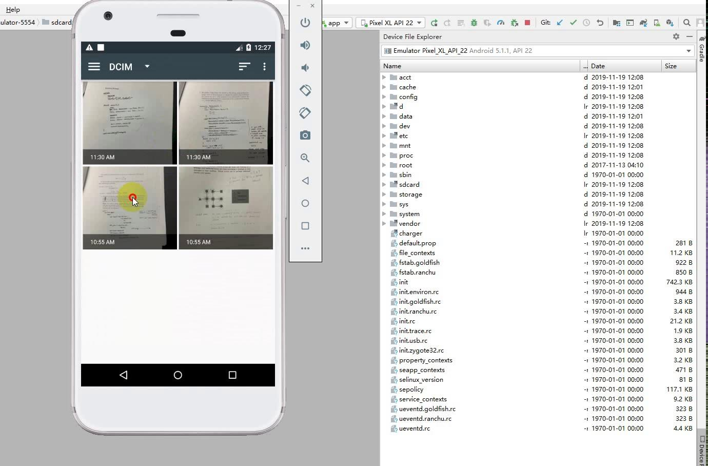
upload multiple pictures

Slide 11
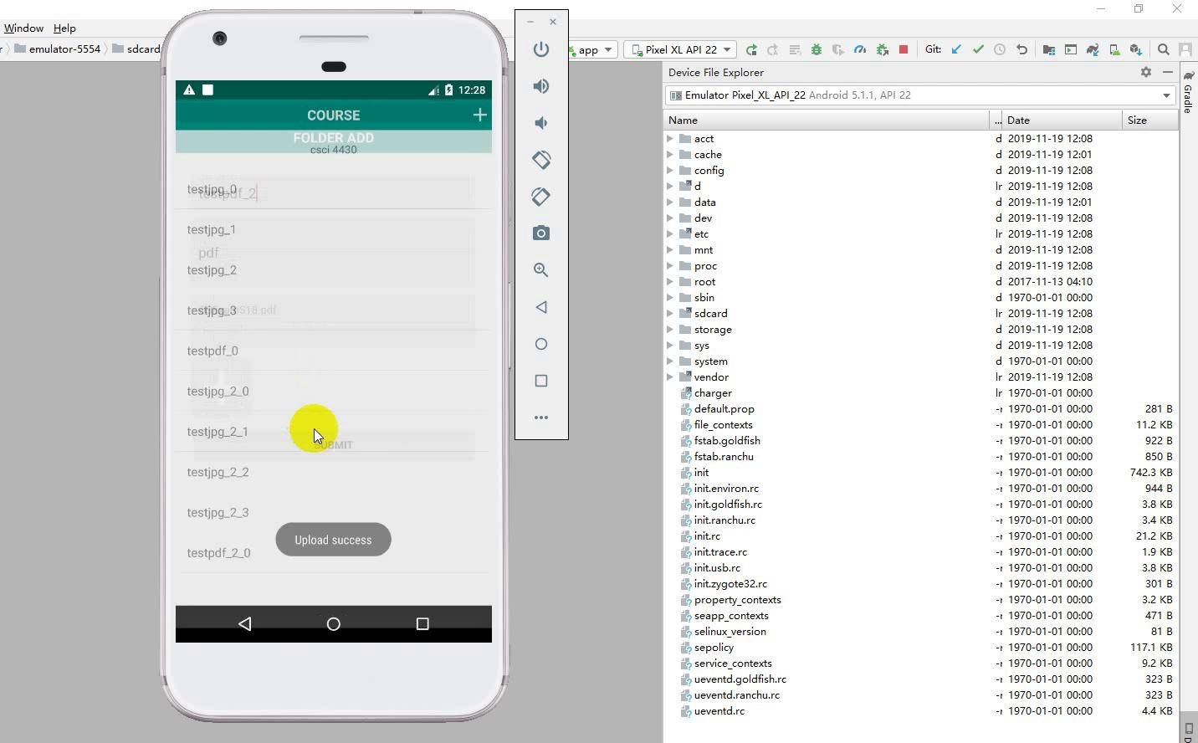
upload a pdf file

Slide 12
Scene 3: Marking the calendar
Don’t want to miss a due day or exam
Make a calendar for yourself
Add pop-up notification for events on the calendar

Slide 13
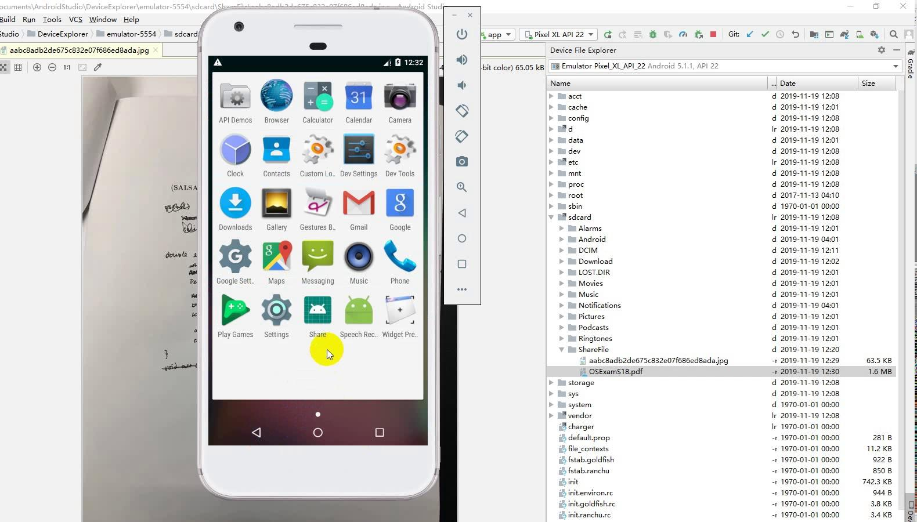
reminder

Slide 14
Scene 4: Comments and ranking
What if someone post a useless or outdated backtest
Users can rate and comment on the uploadings

Slide 15
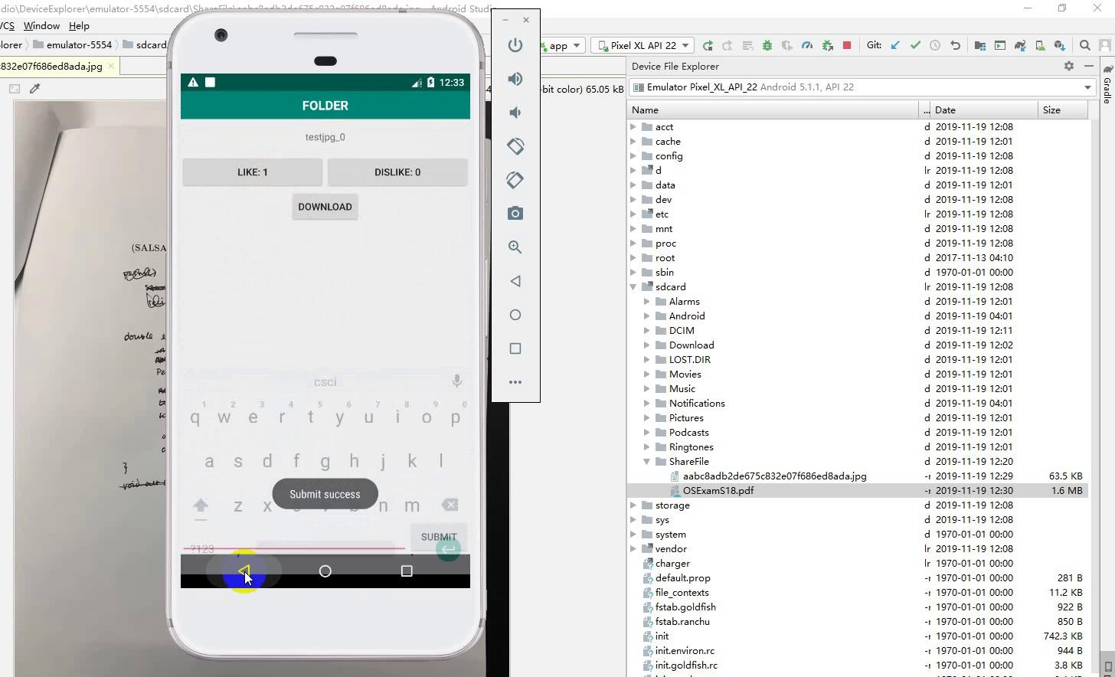
comments and ranking for a file

Slide 16
Documentation
Vision statement, Major product risks, Business case, Project schedule
Static class diagrams, Sequence diagrams, CRC cards
Test plan, Test strategy, List of Test Cases

Slide 17
Future Work:
Automatically deal with useless uploading based on number of students dislike it (challenge system).
Support assigning certain users as administrators.
Design a more user friendly interface (adding tool bar ).
Collaborate with APO office. Scan and upload the test materials they have.
Optimize the database that we use.
Link to our repo: https://github.com/Sakurailulu/RCOSTestCracker
We look forward to more members joining us!

Slide 18
Thank you
Time for questions

